Slide 1
Housing Price Prediction
EDA Steps

Slide 2
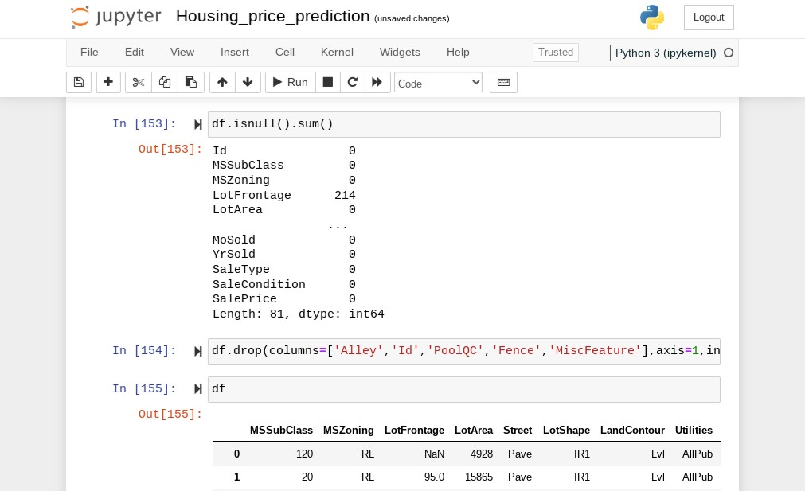
Finding Missing Values

Slide 3
EDA STEPS:-
DataTypes.
Finding missing Values
Imputation of missing values.
Plotting features with target variable.
Encoding Target Variable.

Slide 4
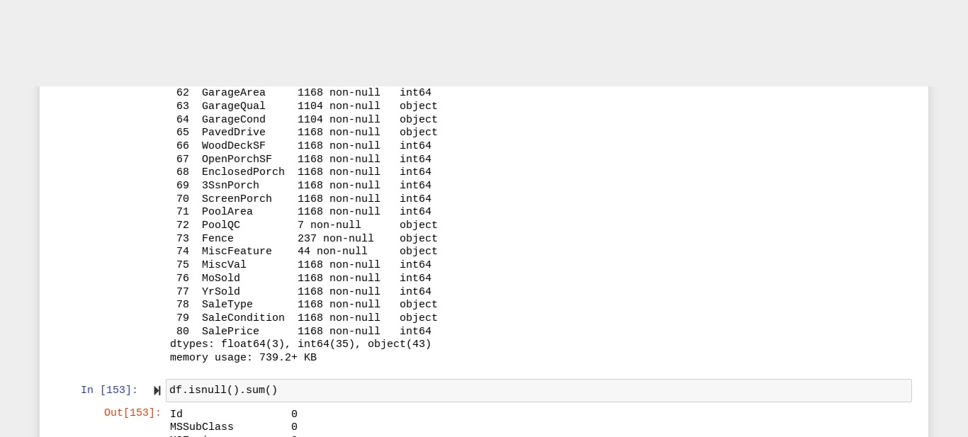
Data Types

Slide 5
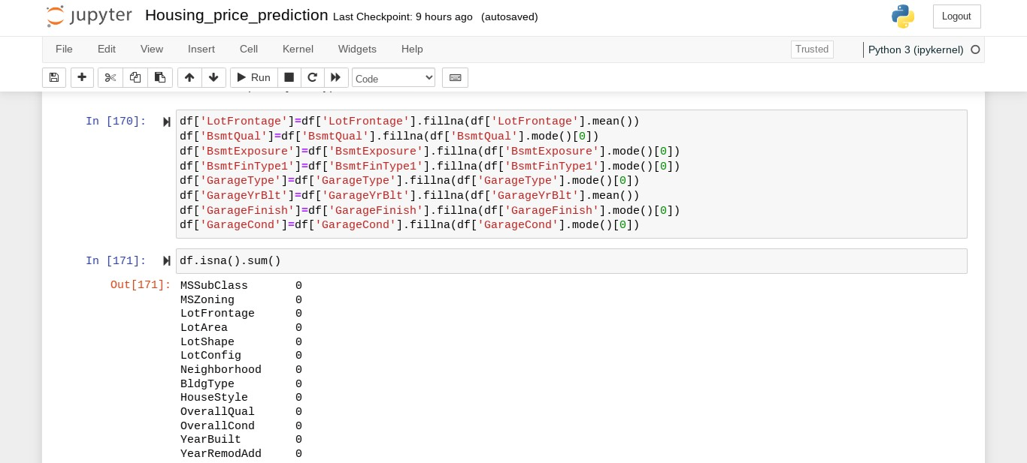
Missing Value Imputation

Slide 6
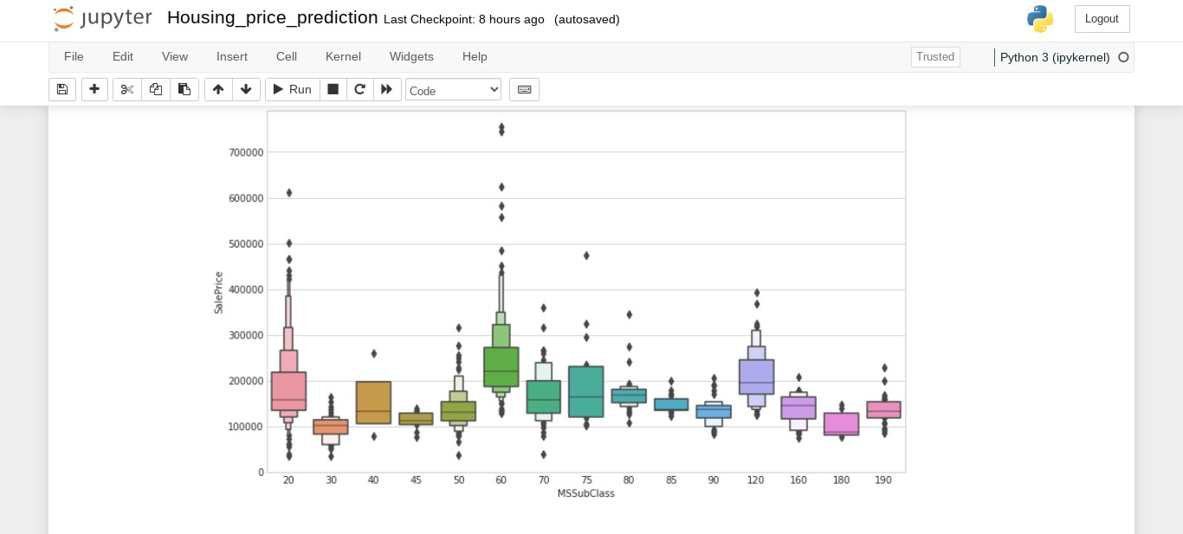
Relationship With Sales Price Of House

Slide 7
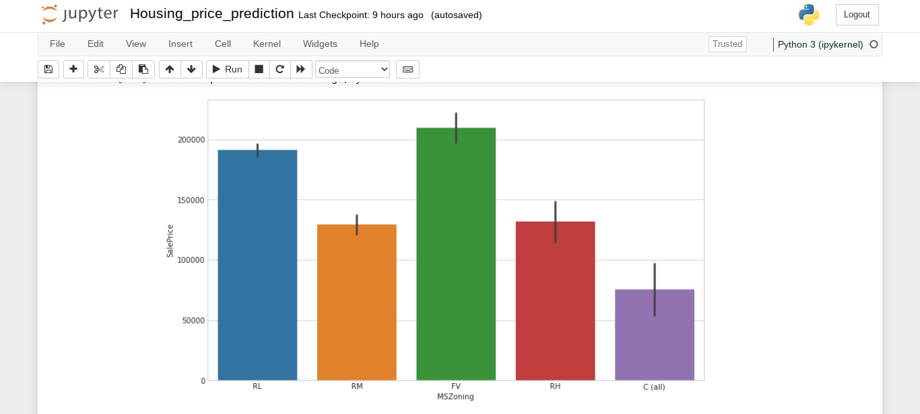

Slide 8
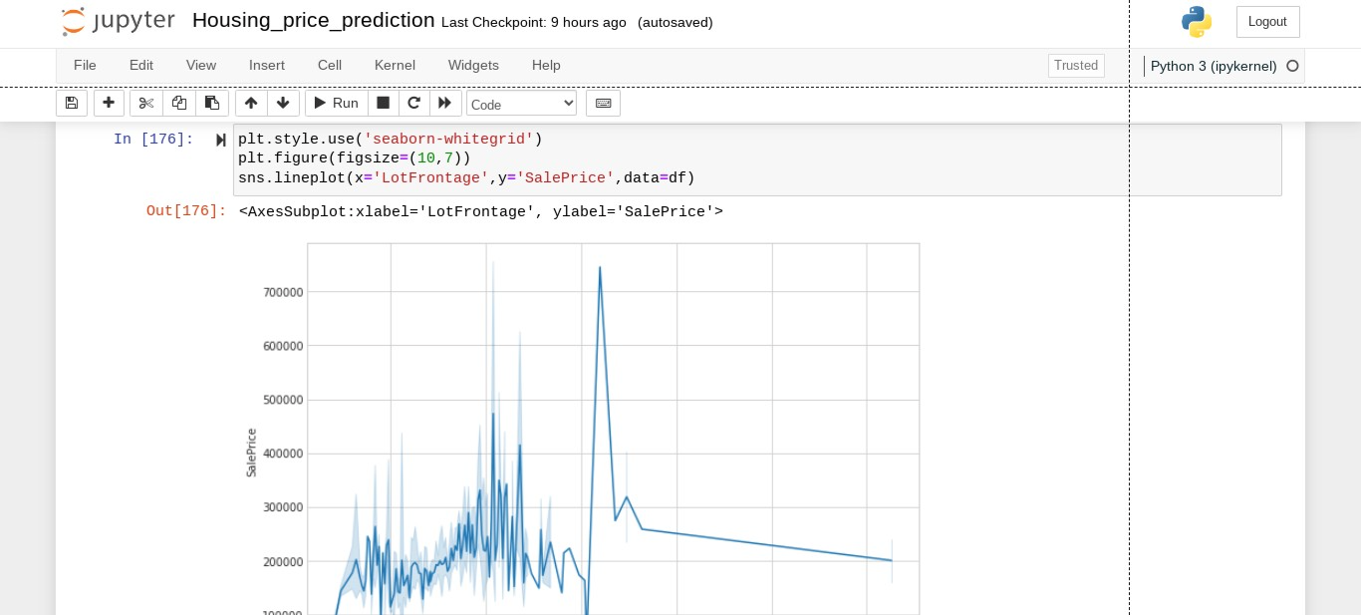

Slide 9
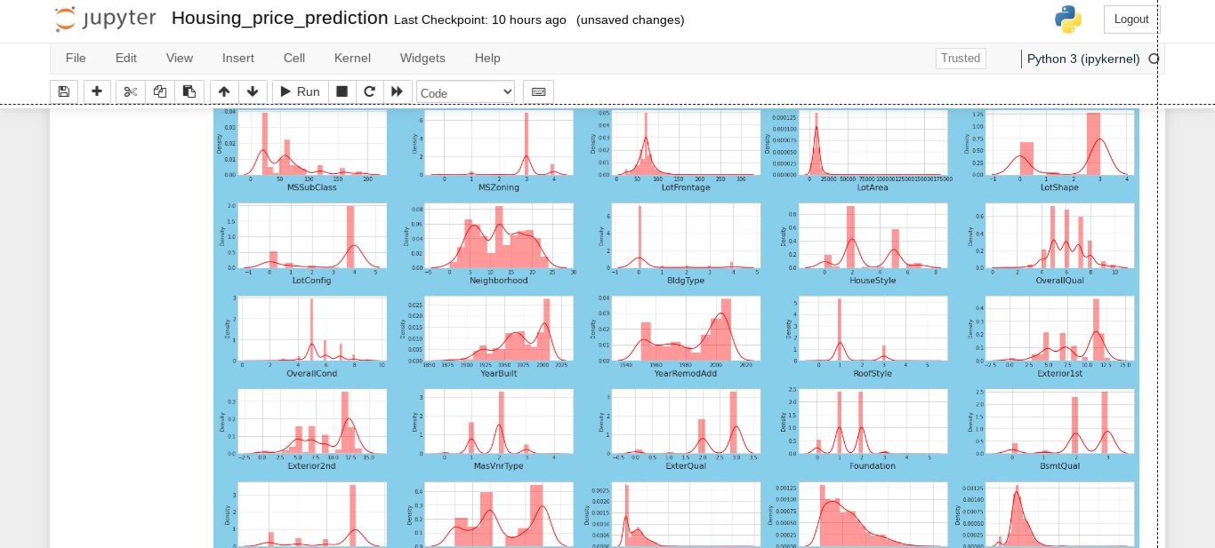
Finding Skewness

Slide 10
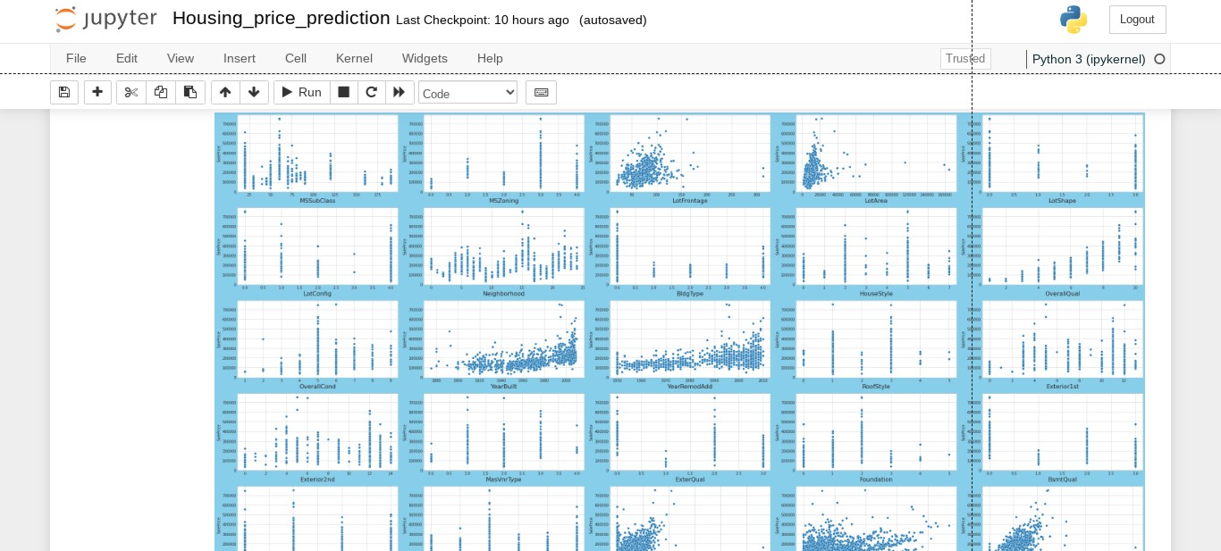
Relation With Target Variable through Scatter Plot.

Slide 11
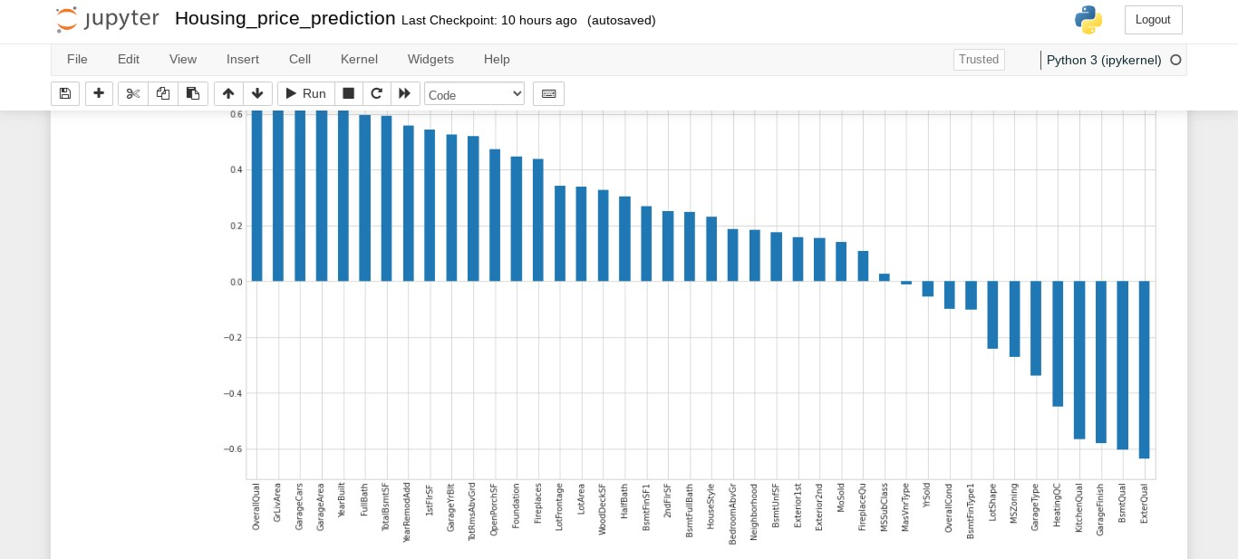
Feature Importance

Slide 12
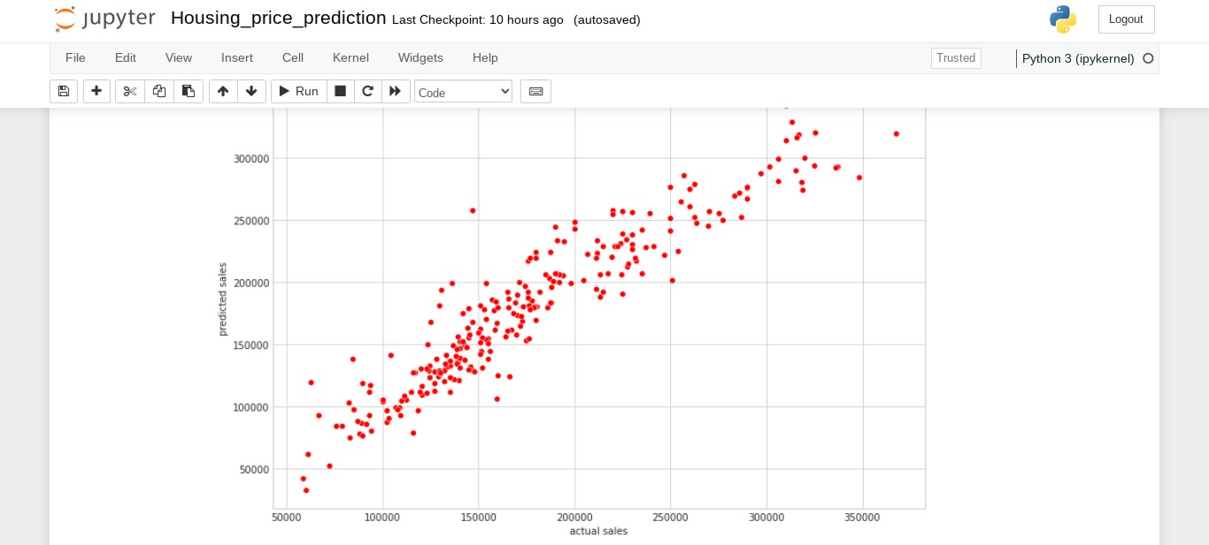
Actual vs Predicted Sales

